Slide 1
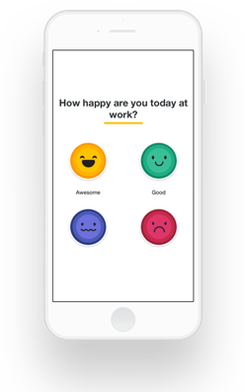


Happiness inside a job: a social network analysis
Guillem Duran Ballester → @Miau_DB
Jose Berengueres → @Harriken
github.com/Guillem-db/PyData-Bcn-2017
Notes:
This talk will be about how to analyze social network data
*from a mobile phone application in order to predict employee turnover
as an indicator of employee happiness.
We will explain how to use machine learning and network analysis techniques
to build a model/ that allows to rank employees /by their risk of quitting their job.
This measure is important because an employee who quits
can represent an expensive problem,
and churn risk
can be used as a great kpi /for your human resources department. (37s)

Slide 2
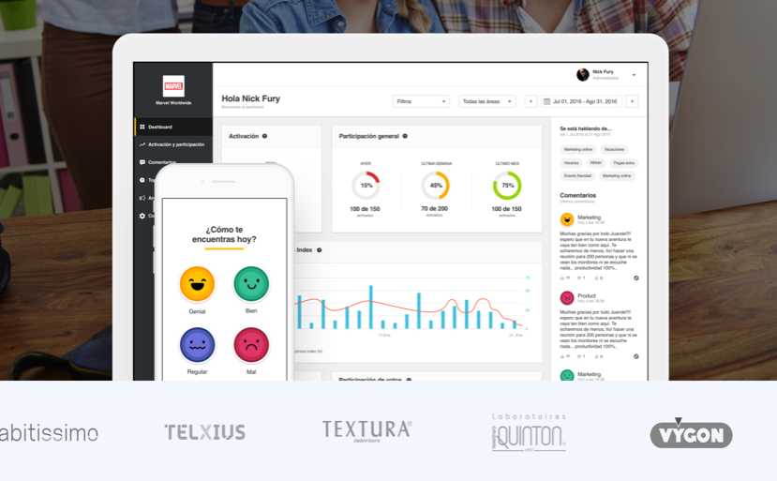
Dataset – source: myhappyforce.com
Notes:
Let’s start talking about the source of our data.
For 2 years / Happyforce
has been helping companies
with an app
that they deploy to understand its workforce better.
This app is meant to be used by employees
to provide feedback to both
their company
and their peers. (15s)

Slide 3
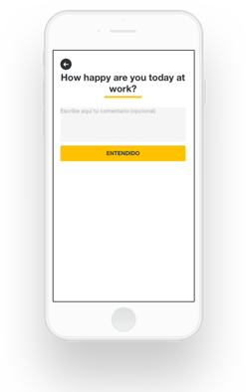
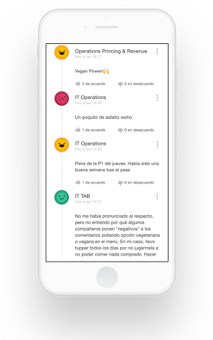
Dataset – Monitoring happiness with an app
Notes:
From an employee perspective,
there are three three main features
that can be used by the employees:
First, the employees can vote
based on their happiness level.
They can also give feedback as anonymous comments,
that can be read by other employees of the same company,
The comments, will be posted on a company forum,
where the employees/ can anonymously like or dislike
other peers comments.(22s)
(1:15 min)

Slide 4
Outline
The dataset
Exploring the data
Social network analysis
Modeling churn
Show me the code!
Notes:
This talk will cover some of the aspects
that have to be taken into account
when building a churn risk model,
such as:
[c] What kind of information we have available.
[c] How the data looks like.
[c] How we can use graph theory, to gain insight on our dataset
[c] How to build machine learning models to predict/ and explain employee churn.
[c] And finally, we’ll have a look at the notebooks
used to perform this analysis. (28s)

Slide 5
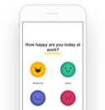


Dataset – size
Table (Rows) | Feed-back | UI flow
Happiness votes (221k) | How happy are you at work today? - 4: Great - 3: Good - 2: So-so 1: Pretty Bad | 1stscreen
Comments (29.5k) | Comment box (optional) | 2nd screen
Likes (284k) Dislikes (52k) | Anonymous forum Users can: - view comments - like a comment - dislike a comment | 3rd screen
Notes:
Here we can see the amount of data
that has been collected during the last two years
corresponding to each one /of the app features.
This data is stored in 4 different csv files,
each one containing different types of information. (14s)

Slide 6
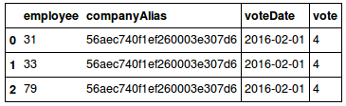
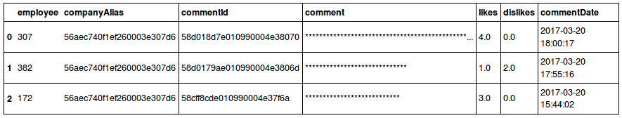
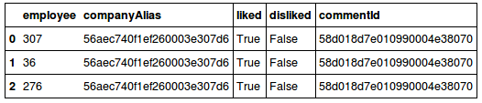
Dataset – pandas
Votes
Comments
Likes/Dislikes
Notes:
The votes csv contains the happiness vote related information.
It not only contains/ the numeric value of the votes/ issued by an employee,
but also the date/ in which the vote was issued.
In order to uniquely identify an employee,
all the csv contain the same two columns:
An integer identifying the employees,
and an identifier of the company that they belong.
*Note that the employee number can be repeated in different companies,
so if we want to be able/ to uniquely identify an employee
we will have to use the emplee/ and companyAlias tuple.
Regarding the comments information,
the content has been anonymized while maintaining
its original number of characters.
You can also find a column containing /the date the comment was posted,
and the number of likes and dislikes/ the comment received.
There is also a csv file available
containing the likes and dislikes/ an employee gave to a comment.
It is possible to know which employee
liked or disliked a given comment,
but we have no timing information/ about when that happened. (55)

Slide 7
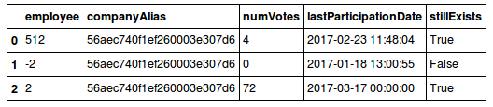
Dataset – Gathering churn info
One more csv available:
Churn based on two columns:
LastParticipationDate.
StillExists
Notes:
Finally,/ we have one more csv file
that allows us/ to extract the churn information
from a given employee.
This file contains the date
of the last interaction of an employee /with the app,
whether an employee is still signed up in the app
or not,
and how many votes the employee issued. (18s)
(1:55)

Slide 8
Recap
The dataset
Votes, comments, inter., churn
4 csv files
4356 employees 34 companies
Notes:
This means/ that we have available information/ about:
votes/comments/interactions/and whether an employee /is still signed up /or not
This information is stored in four different csv files
that contain information from 34 different companies
and more than four thousand employees

Slide 9
Outline
The myhappyforce dataset
Exploring the data
Social network analysis
Modeling churn
Show me the code!
Notes:
Now that we are aware/ of the structure of the data
let’s see how it looks like. (5s)

Slide 10
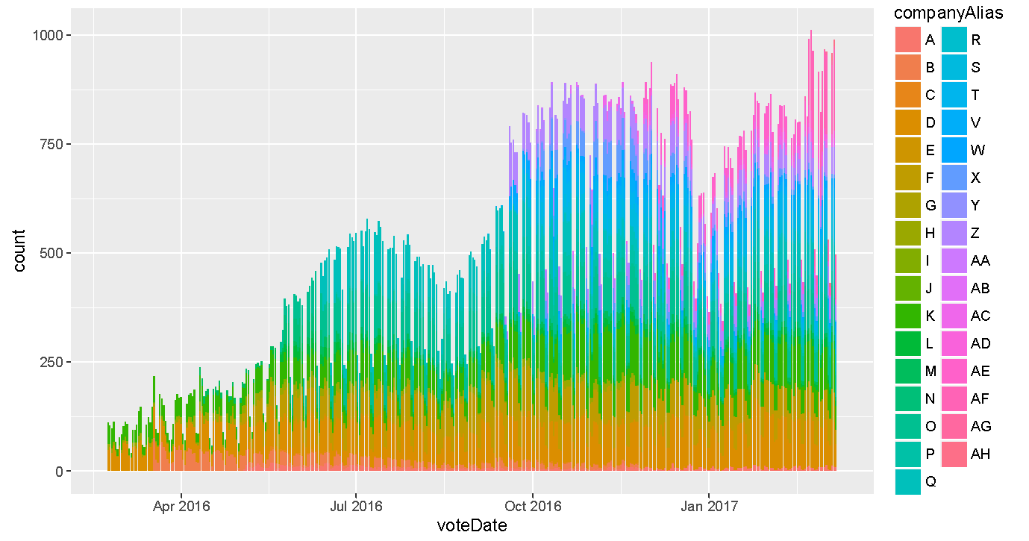
Exploring the data – usage & growth
Notes:
This chart /shows the count of votes /issued daily /grouped by companies.
Most of the votes were cast during business days,
and this is the reason why /we can see some small dips,/ corresponding to weekends.
It also shows a growing trend
both in the number of companies, /that signed up in the app,
and the number of votes that were issued. (25s)

Slide 11
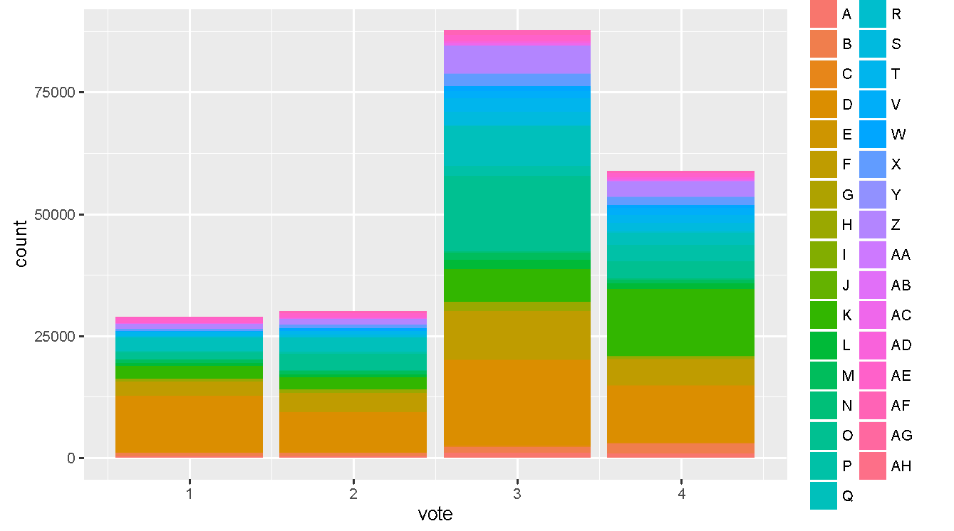
Exploring the data – the “universal” bias towards “good”
LESS HAPPY
MORE HAPPY
Notes:
This is the votes information representing the answer to the question
[1] “How happy are you today at work?”,
and its answer
[2] represents a numerical value ranging from 1 to 4.
Note that there is no neutral answer,
and therefore
people tend to choose/ 3 over 2 /to account for neutral happiness.
It turns out/ that is easier to say/ “I’m good” /rather than “meh” (26s)
+
or maybe / this bias effect/ it is because the first two don’t have name
and people gets confused about what they mean.

Slide 12
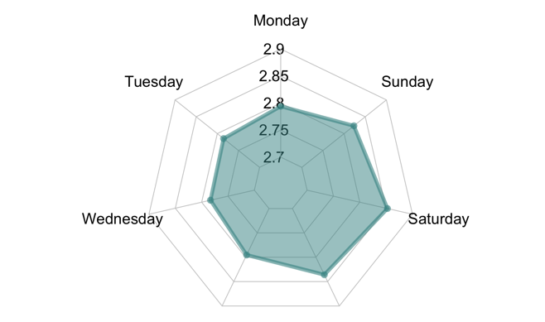



Exploring the data – effect of weekday on happiness
Kolmogorov p < 1e-10
Notes:
[1]This radar chart shows
the average employee happiness
on a given week day.
[2]The surprise here
is that Tuesday,
not Monday
is the least happy day.
[3] However,
the biggest drop in happiness /is from Sunday
to Monday (20s)

Slide 13
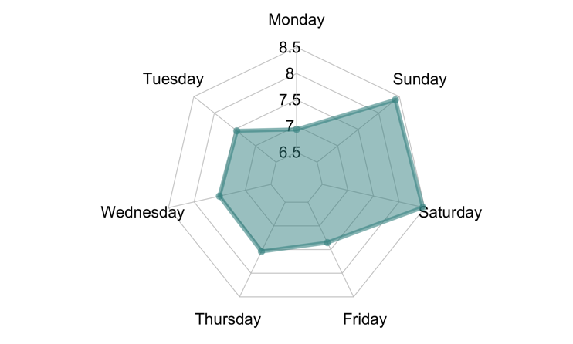
Exploring the data – effect of weekday on likes received
Kolmogorov p < 0.00000000001
Notes:
*** popular wisdom says…
“You should never accept / a job interview/ on a monday/ nor a friday”.
Well, the same is true/ when posting a comment…
***This radar chart shows
the number of likes/ that a comment has received
/depending on the day of the week/ that it was posted.
On average
a comment receives/ 7.5 likes.
However,
the day the comment is posted /has a great influence
on the number of likes/ that it will receive.
A comment posted on a monday
will receive on average
*1.5 likes less
than one written on Sunday.
Monday and Fridays
are the “worse” days to post /(if you want to be liked). (45s)

Slide 14
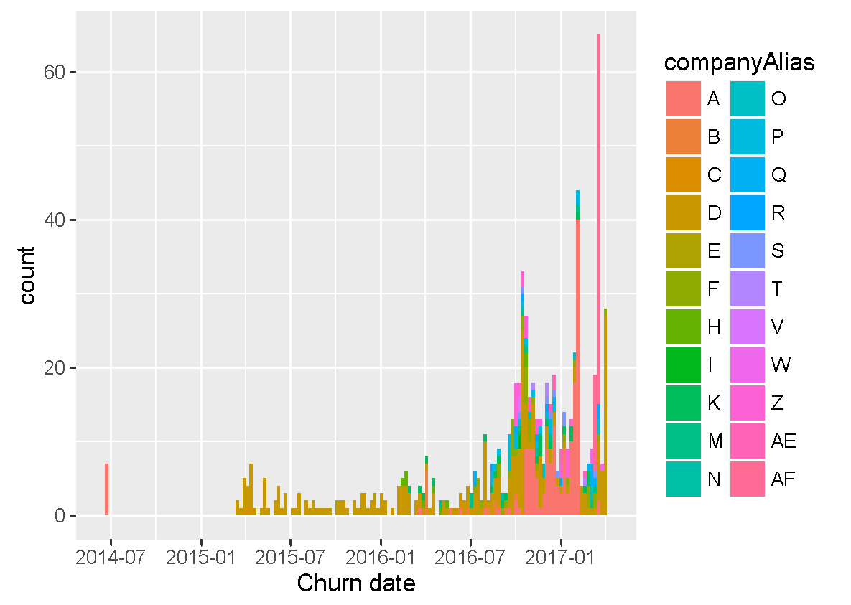
Exploring the data – churn timeline
Notes:
To conclude our exploratory data analysis
we will plot a timeline for the churn information
extracted from the fourth csv file.
In this figure
it is possible to see / a timeline describing
the number of employees that quit
grouped by companies.
It is possible to notice
that at least three things
about the displayed data
that could make our model fail.
First , A group of employees churned in June fourteen(14).
After that/ no employes churned until March fifteen(15).
You can also see how
until january sixteen,
all the employees that churned /belonged only to one company.
And finally, you can see a whole company churning the same day
,on March seventeen.
These irregularities
mean that if we want to build
a consistent machine learning model,
we will need to do some data cleaning. (50-55s)
(2:50)

Slide 15
Recap
2. Exploring the data
Visualize your data
Imbalanced dataset
Strong influence of the weekdays
Notes:
Do not forget to visualize your data to get a sense of whats going on.
this way is easier to spot trends/ and imbalances in the dataset
And do no forget to evaluate weekly and seasonal effects.

Slide 16
Outline
The dataset
Exploring the data
Social network analysis
Modeling churn
Show me the code!
Notes:
As we are seeing some inconsistencies /in the database,
we will use graph theory
to build an alternate representation / of the dataset.
This way
it will be easier to see
what is really going on with the data. (13s)

Slide 17
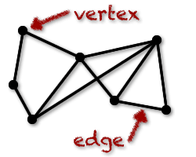
Social network Analysis - what is a graph
Notes:
This graph representation
will be useful for 2 things:
Assess the data integrity /of our dataset
See how the employees/ are related to each other
(this is: extract features that describe
how the employees of a company interacted).
As you already know,
a graph is a mathematical object
comprised of /vertexes /also known as nodes,
and edges. (25)

Slide 18

Social network analysis - from a dataset to a graph
Notes:
But there are several ways to choose
what kind of information they will represent.
In our graph, nodes represent the employees,
and the edges will represent/ information about how/ two employees are related
We can define this relationship in different ways.
This means / that we can use different rules
to indicate when an edge will be drawn between two nodes.

Slide 19

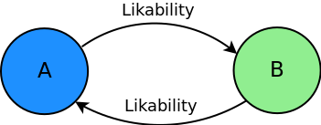
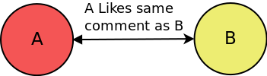
Social network Analysis - Three main ways to...
Undirected
Interactions = Likes + Dislikes
Directed
Likability = Likes / Interactions
Notes:
For example,
one of the most simple / yet effective representation
is the undirected graph of interactions.
(Interactions are the likes + dislikes.)
where the weight/ of each vertex
is proportional to the number of likes
plus the number of dislikes / that two employees / gave each other.
(likability = likes / likes + dislikes)
In this example, the direction of the connections is not relevant.
It will be relevant/ if we choose to represent our data
as a directed graph.
This means,/ that employee A liking employee B
will not be the same as/ employee B liking A.
There can also assign / different weights to the edges,
For example/ instead of the number of interactions,
we could weight each vertex using the ratio of likes
to the total number of interactions.
For the record,/ we call this quantity Likability
There are many more possibilities
when building a graph representation.
Another way to define our edges
could be to link two employees
if they liked/ or disliked the same comment.
Once the graph is created
we can use bokeh to represent it. (60s)

Slide 20
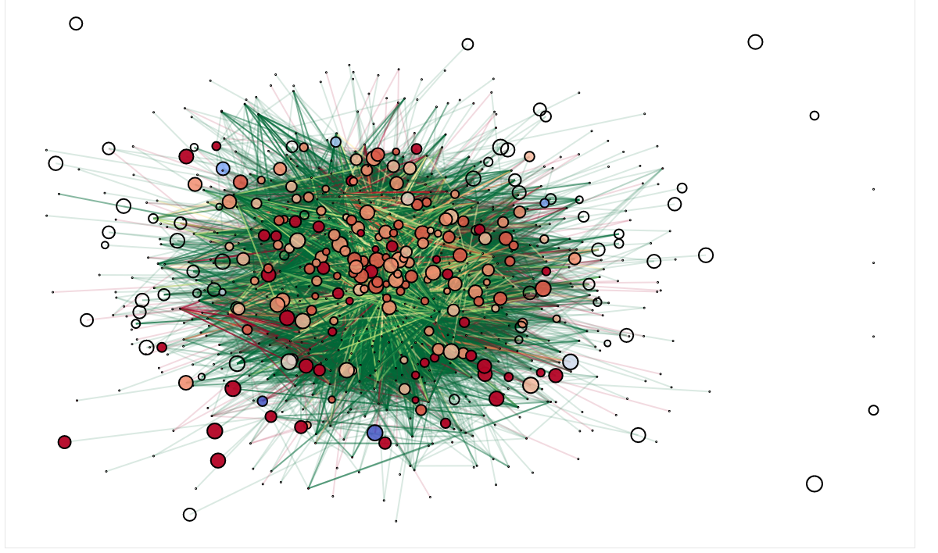
Social network Analysis – Intra company interactions
Notes:
In the following plot /you can see how /the different employees of a company/ interacted among each other.
We have also used/ line and marker properties/ to highlight different aspects/ of the dataset.
When representing each node, /we have used the size
and color properties of the plot
to display information about our data.
Each node,/ that represents an employee,
is colored according to the ratio of /likes to interactions/ that their comments received.
This is,/ its likability
[c] Nodes that have no information available / about the likes received
are represented/ as transpárent circles,
while the other employees/ are coloured from blue, /used to represent low values,
to red/ to represent high values.
The size of the node,/ is proportional/ to the mean happiness votes/ recorded for each employee,
while the nodes displayed as points, have no vote information available.
We have also colored the edges proportionally to likability between to employes.
A red edge will indicate a high proportion of dislikes
while a green edge / will indicate a high likability.
Using this representation it is easy to see that a lot of information is missing. If we dig deeper we will discover that all that missing information belongs to either churned employees that were partially deleted from the database, or employees who barely used the app. This means that if we want to build an unbiased classifier we will need to filter out all the employees with missing information. If we didn’t do that we would find that our classifier would be trained to spot missing data instead of churned employees. #mola, no tocar (90s)
Regarding employees, each node is colored based on the ratio of likes and dislikes an employee received, ranging from blue for the lowest, to red for the highest likes to dislikes ratio. The employees represented by a transparent node did not receive any likes nor dislikes. The size of each node is proportional to the mean happiness level of an employee. All the nodes that are represented by an extremely small circle do not have any vote information available.
----------------------------------------------------------------------------------------------------------------------------------------------------------------------------------------------------------
We have created a graph with networkx that shows:
Node color: ratio of likes/dislikes received. from blue(low) to red(high). Hated people is blue. No color means that they have no likes recorded.
The ratio of likes/dislikes as edges. Green is higher and red is lower.
Size is a function of happiness. Bigger is happier. No size means nan.
We can see that a lot of information is missing. This information corresponds either to churned employees who were deleted from the database, or unreliable employees who barely used the app.
Clearly some filtering is needed

Slide 21

Social network Analysis – Filtering and cleaning
PREDICTION
Employee individual features
Company-wide features
Employee-Company features
CHURN?
Graph features
WEEKS
Keep employees:
Used the app after the prediction date.
More than 5 votes and 5 likes/dislikes.
Notes:
If we want to avoid misleading our classifier, l employees:
some data cleaning /and filtering is required.
In order to predict /the churn risk of an employee
[c]we will start by selecting/ an arbitrary prediction date
and an observation period.
[c]We will try to predict if an employee will quit/ after the prediction date,
and during the observation period, using only data prior /to the prediction date.
[c]We will only model employees
Who used the app after the prediction date,
who issued at least 5 votes,
and who interacted with their peers/
above a threshold /of 5 likes or dislikes. (30s)
#arreglar animacions

Slide 22
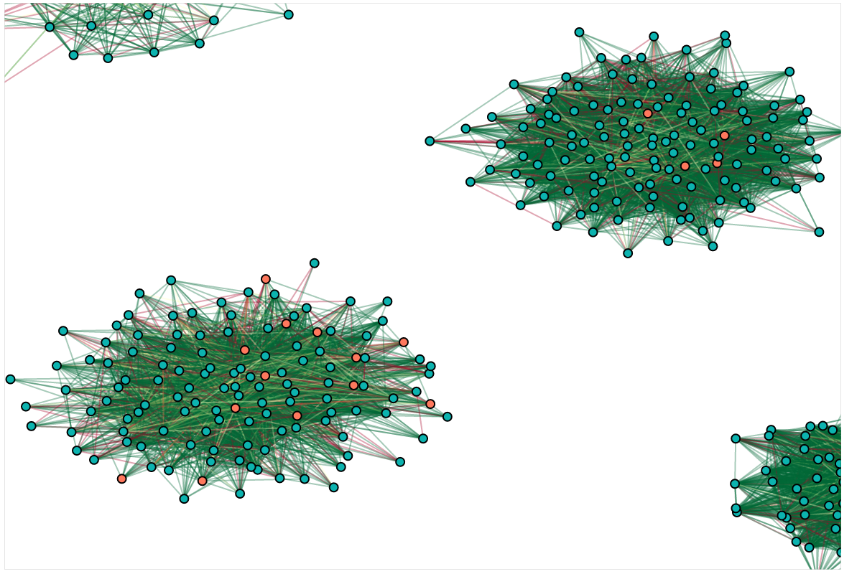
Social network Analysis – Happiness as a graph
Company D
Company K
Notes:
In this slide
we can see how some of the companies look like / once the filtering process is done.
We have used the same coloring scheme for the edges
as the one used in the previous slide,
but in this case
we colored each node / according to its churn information.
We can see that/ the resulting company graph/ has only one component,
and the employees /that will churn during the observation period
are colored in red. (25s)

Slide 23
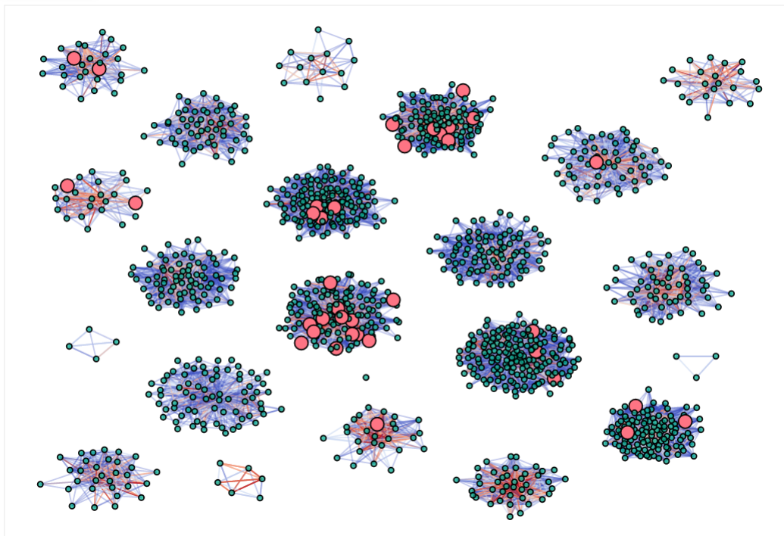
Social network Analysis – Filtered employees & churn
Notes:
Here we can see,/ all the companies in the dataset/ where the employees who quit
are big, and red/ so they are easier to spot. (10s)
#possible afegir una frase per omplir
(4:35)

Slide 24
Recap
3. Social network analysis
Directed/Undirected
Weight is important
Line & markers to display info

Slide 25
Outline
The dataset
Exploring the data
Social network analysis
Modeling churn
Show me the code!
Notes:
Once we have cleaned our data,
defined our prediction date
and defined our observation period,
it is time to create the features/ we will use
in our predictive model. (10s)

Slide 26
Modeling churn - database features
PREDICTION
Employee individual features
Company-wide features[1]
CHURN?
Employee-Company features
Social features
WEEKS
[1] First used in LinkedIN job search ASONAM 2016
Notes:
Using only data from the remaining employees
that was collected /before our prediction date
we will extract features/ belonging to four different categories.
[c]Employee individual features
such statistics on the number of comments,
votes/or likes and dislikes/ given and received.
[c]we can also calculate the same features at a company level
**common to all the employees belonging to the same company
** first used in linkedin job search algortithm improved +10% job match
[c]And then /normalise the employee individual features
by its company counterpart.
[c]It is also possible to use network theory
to extract additional features/ that help us understand
our data better. (37s)
#repassar pronunciació

Slide 27
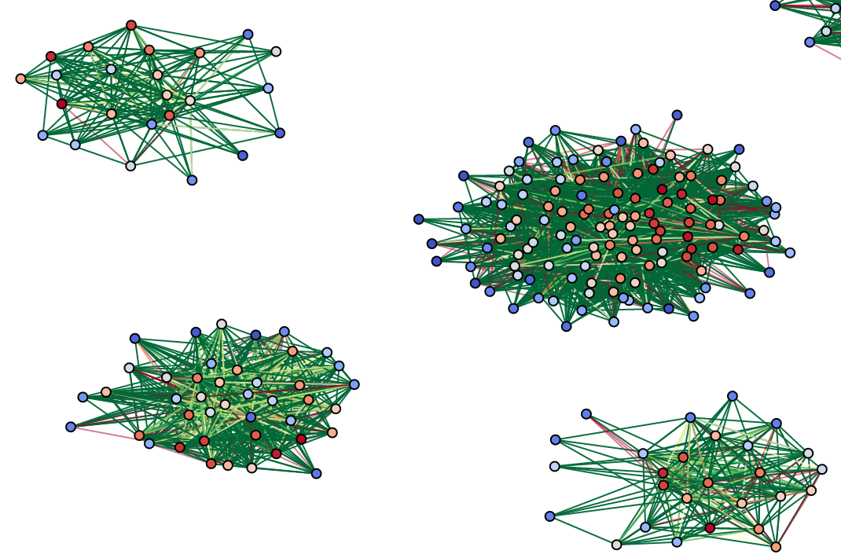
Modeling churn - Representing NMF 1
Notes:
One of these graph features, /is Non negative matrix factorization/ or en em ef(NMF)
that is a clustering technique /applied to the adjacency matrix of a graph
Here /we can see a graph feature/ extracted using the NMF, /
NMF could be though /as a kind of principal component analysis for graphs,
that allows us to reduce / the information from/ the adjacency matrix /into the number of components that we choose.
The NMF divides the graph into different components
each component representing a different cluster
or group of employees
In this plot,/ the value of the first component
is represented using a colormap /ranging from blue/to represent low values
/ to red/to represent high ones (55s)
---------------------------------------------------------------------------------------------------------------------
For example, in the following plot we can see represented the first NMF clustering component of a company graph. This value indicates how much a given node belongs to that component. As this is a continuous value, one could establish a threshold to consider a node part of a group, or even apply a discretization process to each component in order to find subgroups inside a graph.
To conclude with our features engineering process, we can see how the values on the first component can be discretized to emphasise different subgroups in a graph.

Slide 28
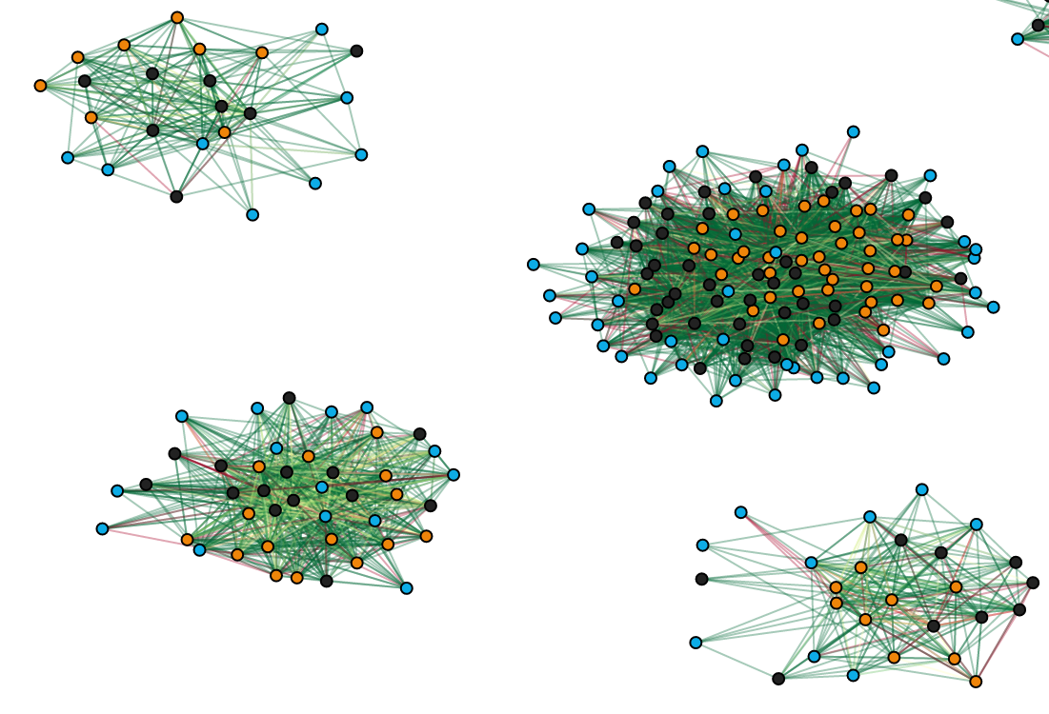
Modeling churn - Representing NMF 2
Notes:
The resulting components/ of the NMF / are continuous values.
This values indicates how much that node/ belongs to the cluster.
Sometimes/ it is useful to discretize those values into bins.
This way /it may be easier to discover/ new communities in the graph.
In this plot, you can see the effect of discretizing the first component into three values,
low as blue, neutral as black, and high as orange
(30s)

Slide 29
Modeling churn - The GBM
Churn Prediction
within 3 months P@50=75 % correct
Notes:
To model our data, we have chosen / a gradient boosting classifier / trained with default parameters,
an arbitrary prediction date set on X/ and an observation period of three months.
Using this model we achieved a precision of X and an AUC of Y. (25s)
#acabar de omplir

Slide 30
Modeling churn - Quiz time! Which feature is #1?
TOP FEATURES | TYPE | Influence
(a) Likability | Colleagues | 33
(b) Posting frequency | Company | 9.6
(c) Relative Happiness | Relative | 4.2
(d) Relative Variability of Happiness | Relative | 2.4
(e) NMF Comp. 1 | Social | 2.2
(f) Mean Happiness of the employee. | Individual | 1.8
Notes:
What features do you think help predict turnover?
In this table we have the most relevant features of our model.
(E) Likability: defined as the count of likes received / number of intereactions
on the all the comments/ written by an employee in the anonymous forum.
(C) Posting frequency: Is the Average number of comments posted per day,/ and per company.
This is a company-wide feature.
(E) Relative Happiness: Is the employee mean happiness vote/
divided by the company average happiness
(D) Relative Variability of Happiness:
Standard deviation of employee happiness / (divided by)
standard deviation of the company
to which the employee belongs.
(A) NMF Clustering is the social network feature
that we represented in the previous slides
(B) and Mean Happiness/ is the mean of the happiness votes of the employee
Which of the above features
do you think is more relevant
to predict the employees’ churn?
Any guesses?
Well, / it is curious to find out that
likability is the most relevant feature to look at
when predicting employees’ churn.
Because it is not a feature that depends on the individual,
but a feature that depends on the opinion of other employees. (85-95s)
#compara amb happiness votes a priori mes relevant
NEED TO FINISH
Once we have fit our model, evaluating the feature importances can give us additional insight on how our data is structured. Happiness inside a job is a complex emotion that can be influenced by many external things

Slide 31
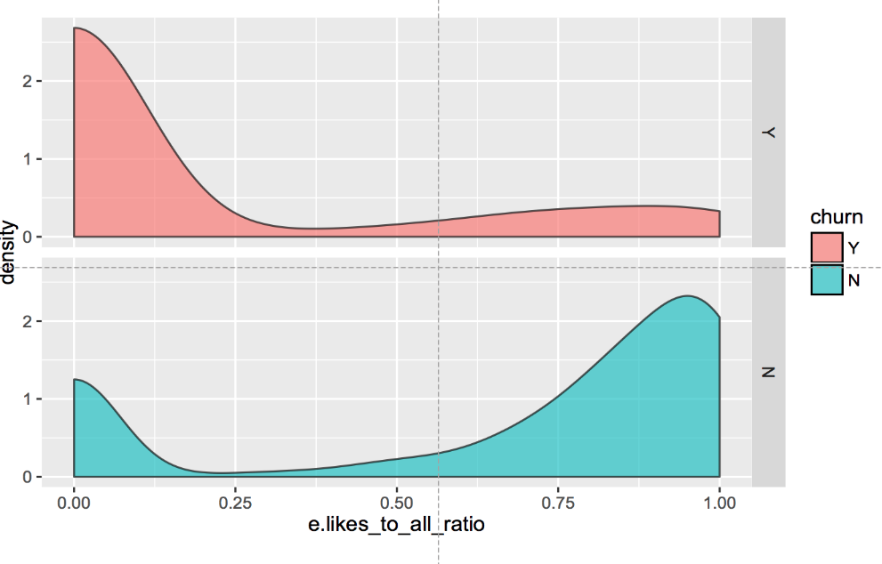
Modeling churn – “Likable” employees churn 3 times less
Notes:
This density plot shows /how the employees that will churn,
and those who won’t
are distributed according to its likability.
We can see that this feature is really relevant
because employees with high likability are far /less likely to churn
(15s)
(4:35)

Slide 32
Conclusions
Measure happiness by what people do, not what they say:
estimate job turnover risk👍
surveys 👎
Happiness (measured as churn risk) depends more on extrinsic elements than intrinsic elements to the employee
Happiness not an inside job
1 in 4 employees “disengaged”
Notes:
Do not forget to measure happiness by what people do, not what they say
Happiness not an inside job
1 in 4 employees “disengaged”

Slide 33
Outline
The dataset
Exploring the data
Social network analysis
Modeling churn
Show me the code!
Notes:
This talk will cover some of the most important aspects that have to be taken into account when building a model that allow us to rank employees by churn,such as:
What kind of information we have available.
How to transform the tables of the dataset into a graph representation.
How to extract useful features that allow us to profile the employees of a company
Building ML models to predict employee churn and happiness.
What we can expect from our models and how we could improve them.

Slide 34
Backp up slides
Notes:
QUIZZ TIME What features do you think where the most important in predicting which employee will quit? I have a prize for the ones who get it right.

Slide 35
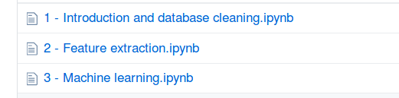
Notebook playground
github.com/Guillem-db/PyData-Bcn-2017
Notes:
If you are interested in the topic you can take a look at the additional notebooks provided as a backup material for this talk. There you can find an step by step explanation on how the data analysis was performed. There are 5 different notebooks, each one addressing a different subtopic such as data loading and cleaning, feature extraction techniques, how to perform data augmentation, Machine learning model evaluation and feature selection or graph visualization tips. It is alo possible to find the R code used to train the grad boosting classifier used to predict the churn risk of an employee.
Notebooks :
Data cleaning
Feature Extraction
Data augmentation
Machine Learning
Visualization
R code for churn analysis

Slide 36
Network analysis - Extracting features
Descriptive features:
Number of nodes/edges → Number of employees/interactions
Degree → Different interactions an employee has
Centrality features:
Betweenness → Influence of a given employee
Closeness → Different interactions an employee has
Clustering features:
Non Negative Matrix Factorization → Reduce information in n comp.
PCA on adjacency matrix → Reduce information in n comp
Community → Find communities inside the graph*
Filtering: MST, MPFG → Keep most important nodes*
Notes:
##REDO
In addition to happiness metric features such as… average hapines, variability, happiness comapre to comapny mean etc…
we also used...
There are several different ways of using graph theory to extract features from a graph representation of a dataset. Besides features such as the degree of a node, that would represent how many different employees interacted with the employee represented by that node, we could also use centrality features and clustering features.
While the centrality features like the betweenness centrality and closeness centrality allows us to quantify how well connected an employee is to their peers. Centrality metrics can be seen as a measure of the relevance of an employee with respect to its colleagues, while the specific type of centrality used allow us to define different kinds of relevance.
It may also come in handy to extract clustering features to represent information about the different subgroups that a given graph can have.
Techniques such as Non negative matrix factorization allow us to divide a graph in n different groups, so we can obtain a set of n values that indicate how much a node belongs each one of that n groups.
It could also be useful to filter the graph assigning each node a binary value describing whether a given node belongs to the reduced graph obtained after applying a filter like Minimum Spanning tree or a Maximum planar filtered graph.

Slide 37
Results - Feature engineering
LIST OF FEATURES (N>100)
Individual features (N=13)
  reported happiness: mean, standard deviation (sd), length of employee comments (in chars): sum, mean, sd.
  count of comments posted per day of observation, count of chars written per day of observation
  likes given in the forum: sum of all likes, mean (per day the app was used), std (per day the app was used).
  count of likes + dislikes received by the employee’s posted comments in the forum, ratio of likes to likes + dislikes.
Company-wide features (N=18 +34).
  Same at company level
Employee-Company features
  Individual features normalized by company average
Social graph features
Notes:
There are several kinds of features that we can extrat.
Individual features: These features depend only on the information related to an employee such as descriptive statistics of reported votes, number and length of the comments written or likes and dislikes given and received.
We also have company wide features, that are extracted using the same method used to extract the individual features but grouping the data by company instead of grouping it by employee.
The Employee-company features are the individual features normalized by the company average. This way we can relate an employee to its peers data.
There is also possible to extract new features using graph theory.

Slide 38
Machine Learning - The GBM
Straighforward improvements:
Data balancing → 10% churn
Data augmentation → 1000 employees
Metaparameter tuning → Default parameters
Advance feature selection → + 200 features
XGBOOST (+10% kaggle)
Notes:
In this case, we have chosen a gradient boosting classifier with default parameters, an arbitrary prediction date set on X and an observation period of three months. Using this model we achieved a precision of X and an AUC of Y.
We tried to keep our model simple, but its efficiency could be improved using the following techniques to correct its weakest spots:
As only about 10% of the employees churned, data balancing techniques such as the one provided by the imblearn python module could come in handy to improve the f1 score of the model
Using data augmentation for generating new data using different arbitrary prediction dates can reduce the variance of our model.
Of course, it is also possible to perform metaparameter tuning to the gradient boosting classifier, but at the risk of overfitting.
Finally, as we can generate more than 200 different features to describe our dataset, using different feature selection techniques such as X and Y could lead to an improvement of the results.
If you take a look to the notebooks of this talk, you will be able to find an implementation of some of the suggested improvements that I just described.

Slide 39
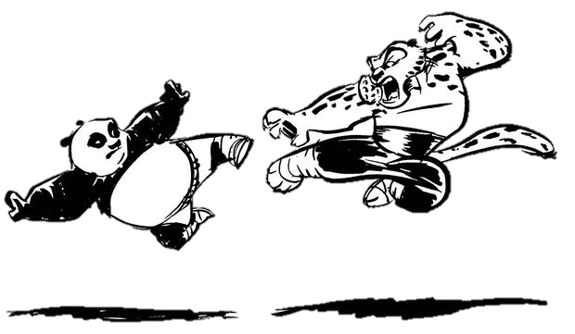


How was it done?
Notes:
The analysis that we described has been done using both R and Python. In our case, R was originally used to create the GBM model, and Python was used to double check the extracted features, create the network theory derived features, and replicate the GBM model to check that the results from both languages were similar.
In terms of performance and complexity both languages showed similar results and capabilities. Although the networkx package is not available in R, similiar alternatives exists such as Igraph.

Slide 40
Back
Measure happiness by facts (job turnover), not via “surveys”
Happiness is NOT an inside job of the top features on only one half is individual, the rest depends on your department peers!
anti-pair coding: use two separate languages, two separate coders to validate models, improve features.
Notes:
QUIZZ TIME What features do you think where the most important in predicting which employee will quit? I have a prize for the ones who get it right.

Slide 41
Goal: predicting turnover
Notes:
DELETE
Our main goal was to predict who will quit. Why? There are many reasons why we would want to be able to make that prediction:
1 - First, because replacing an employee that quits is really expensive for companies. If you can reduce the churn rate of your company you may save a lot of money.
2 - Churn is also a good indicator of company morale, because knowing what percentage of a employees is at risk of quitting, can give you an indicator of the “health” of your workforce. The estimated churn rate of an employee can be a great kpi for HR… ##NOPE so they can plan in the future, detect problems at department level, and take preventive action to reduce the costs associated with a high churn rate.
3 - Furthermore , the data gathered can be used to gain insight on how the employees of a company interact among each other, how the agreement and disagreement is distributed, and how it affects the chances of an employee quitting.

